Slide 1
Analyzing the Marketing Environment

Slide 2
Marketing Environment
Topic Outline
The Company’s Micro environment
The Company’s Macro environment
Responding to the Marketing Environment
Helpful URLS
http://www.learnmarketing.net/
www.marketingteacher.com/

Slide 3
The Marketing Environment
The marketing environment includes the actors and forces that affect marketing management’s ability to build and maintain successful relationships with customers.

Slide 4
The Marketing Environment
Microenvironment consists of the actors close to the company that affect its ability to serve its customers, the company, suppliers, marketing intermediaries, customer markets, competitors, and publics

Slide 5
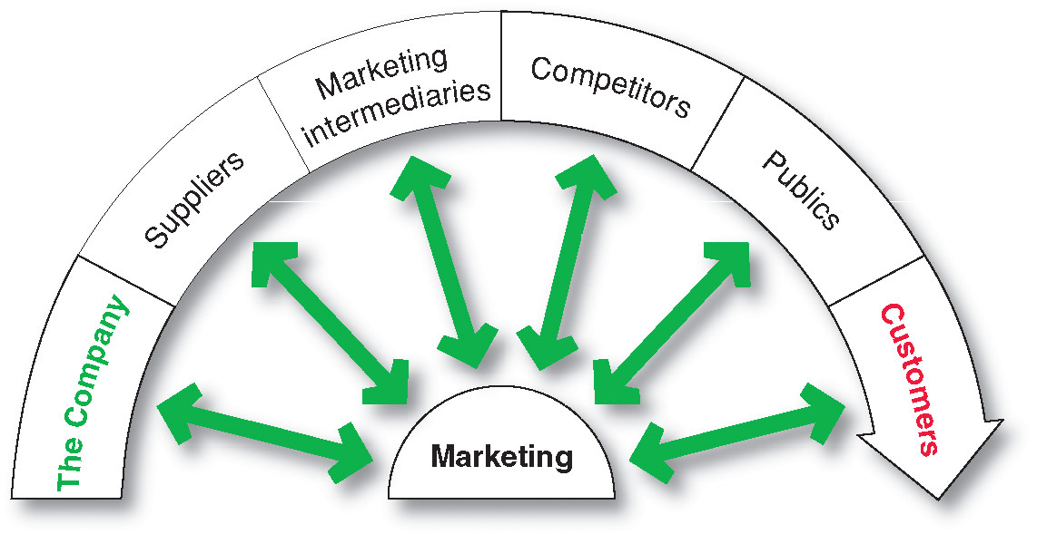
The Company’s Microenvironment
Actors in the Microenvironment

Slide 6
The Company’s Microenvironment
The Company
Top management
Finance
R&D
Purchasing/ Procurement
Production operations

Slide 7
The Company’s Microenvironment
Suppliers
Provide the resources to produce goods and services
Treated as partners to provide customer value

Slide 8
The Company’s Microenvironment
Marketing Intermediaries
Help the company to promote, sell and distribute its products to final buyers

Slide 9

The Company’s Microenvironment
Competitors
Firms must gain strategic advantage by positioning their offerings against competitors’ offerings

Slide 10
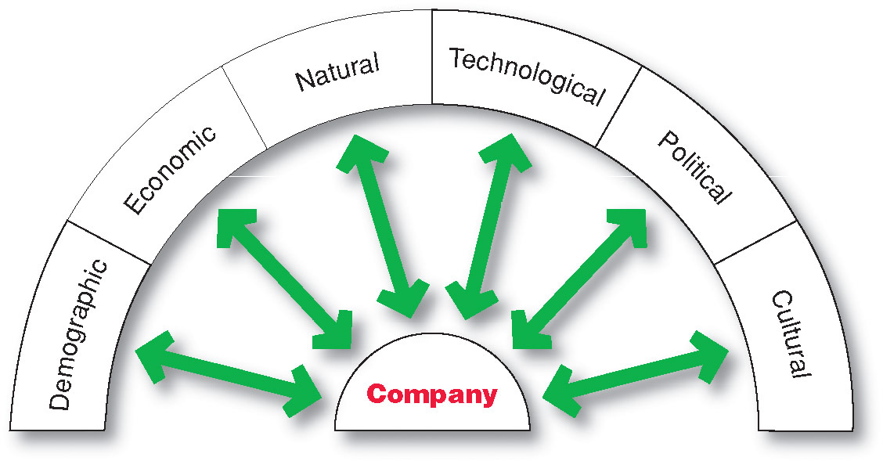
The Company’s Macroenvironment

Slide 11
The Company’s Macroenvironment
Demographic Environment
Demography is the study of human populations in terms of size, density, location, age, gender, race, occupation, and other statistics
Demographic environment is important because it involves people, and people make up markets
Demographic trends include age, family structure, geographic population shifts, educational characteristics, and population diversity

Slide 12
The Company’s Macroenvironment
Demographic Environment
Changes in the Workforce
  More educated
  More white collar

Slide 13

The Company’s Macroenvironment
Demographic Environment
Changing age structure of the population
  Baby boomers include people born between 1946 and 1964

Slide 14

The Company’s Macroenvironment
Demographic Environment

Slide 15
The Company’s Macroenvironment
Demographic Environment
Increased Diversity
Markets are becoming more diverse
  International
  National
Includes:
  Ethnicity
  Gay and lesbian
  Disabled

Slide 16
The Company’s Macroenvironment
Economic Environment
Economic environment consists of factors that affect consumer purchasing power and spending patterns

Slide 17
The Company’s Macroenvironment
Natural Environment
Natural environment involves the natural resources that are needed as inputs by marketers or that are affected by marketing activities
Trends
  Shortages of raw materials
  Increased pollution
  Natural Causes

Slide 18

The Company’s
Macro-environment
Technological Environment
Most dramatic force in changing the marketplace
Creates new products and opportunities

Slide 19
The Company’s Macroenvironment
Political/Legal Environment
Political/Leagal environment consists of laws, government agencies, and pressure groups that influence or limit various organizations and individuals in a given society

Slide 20
The Company’s Macroenvironment
Cultural Environment
Cultural environment consists of institutions and other forces that affect a society’s basic values, perceptions, and behaviors

Slide 21
The Company’s Macroenvironment
Cultural Environment
Persistence of Cultural Values
Core beliefs and values are persistent and are passed on from parents to children and are reinforced by schools, churches, businesses, and government.
Secondary beliefs and values are more open to change.

Slide 22
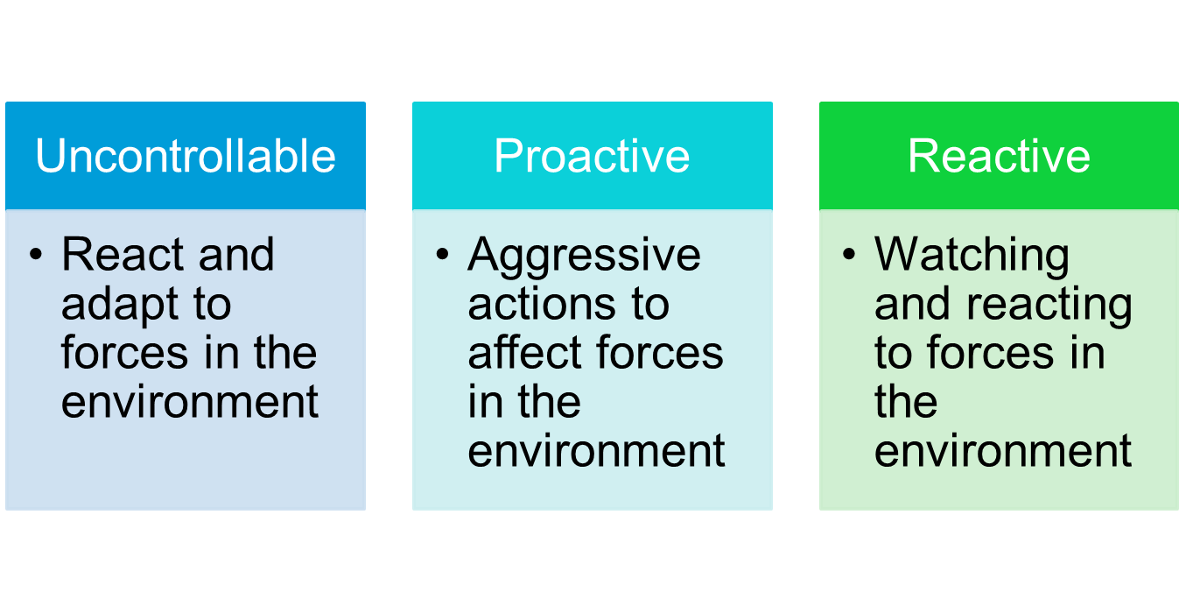
Responding to the Marketing
Environment
Views on Responding

